Slide 1

30 x 30 initiative
What is the best use of THE UK land (AND SEA)?

Slide 2
30 x 30
The UK is one of many nations that have pledged to meet the target under a Leaders' Pledge for Nature. 70 nations have approved this pledge. UK government is leading, since 2019, the Global Ocean Alliance promoting a target to protect 30% of the ocean by 2030.
* But which land and sea areas should the UK choose to protect to get to the 30% target by 2030?
* What should be the focus and where should we protect to allow for the changing climate?
* The UK Prime Minister, in September 2020, has committed to protect 30% of the UK’s land by 2030.
* Designation does not necessarily mean protection: an on-going (long-term) management plan should be implemented and proactively actioned to adjust for climate change.

Slide 3
30 x 30
Innovation – we took a holistic approach to consider both marine and terrestrial use: why? species will move to adapt to a changing climate: there needs to space to adapt.
UK numbers are showing we are within the 30 x 30 initiative targets: we still have degrading environments.
How well protected are these areas? IUCN has 6 protection classifications which do not map directly to UK designations: they range from total protection to land/sea scape designations.
Impact – designating land is not the end of the process, it needs to be an on-going process with proactive local engagement.
Alignment (to COP26) – Nature based solutions are a key theme. The importance of nature will mean that 30 x 30 will have an important role in the future. Ecosystem adaptation can have negative side effects if badly implemented whereas nature based solutions should benefit humans and biodiversity.
Marine / Terrestrial areas – need to have long-term perspective which takes into account species needs under future climate scenarios. Right solutions in the right places which take into account the local context with species and people.

Slide 4
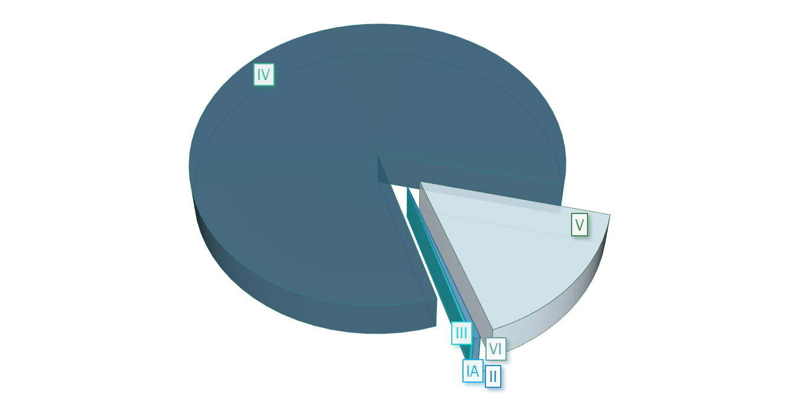
30 x 30: IUCN UK Protected AREAS
Categories:
IA – Strict Nature Reserve
IB – Wilderness Area
II – National Park
III – Natural Monument or Feature
IV – Habitat / Species Management Area
V – Protected Landscape / Seascape
VI – Protected Area With Sustainable Use Of Natural Resources
(>80% of UK protection is in IV / V categories)
LAND
MARINE
Source: https://www.protectedplanet.net/country/GBR

Slide 5
30 x 30: IUCN UK Protected AREAS
Categories:
IA – Strict Nature Reserve
IB – Wilderness Area
II – National Park
III – Natural Monument or Feature
IV – Habitat / Species Management Area
V – Protected Landscape / Seascape
VI – Protected Area With Sustainable Use Of Natural Resources
(>80% of UK protection is in IV / V categories)
Source: https://www.protectedplanet.net/country/GBR
Notes:
Marine – blue.

Slide 6
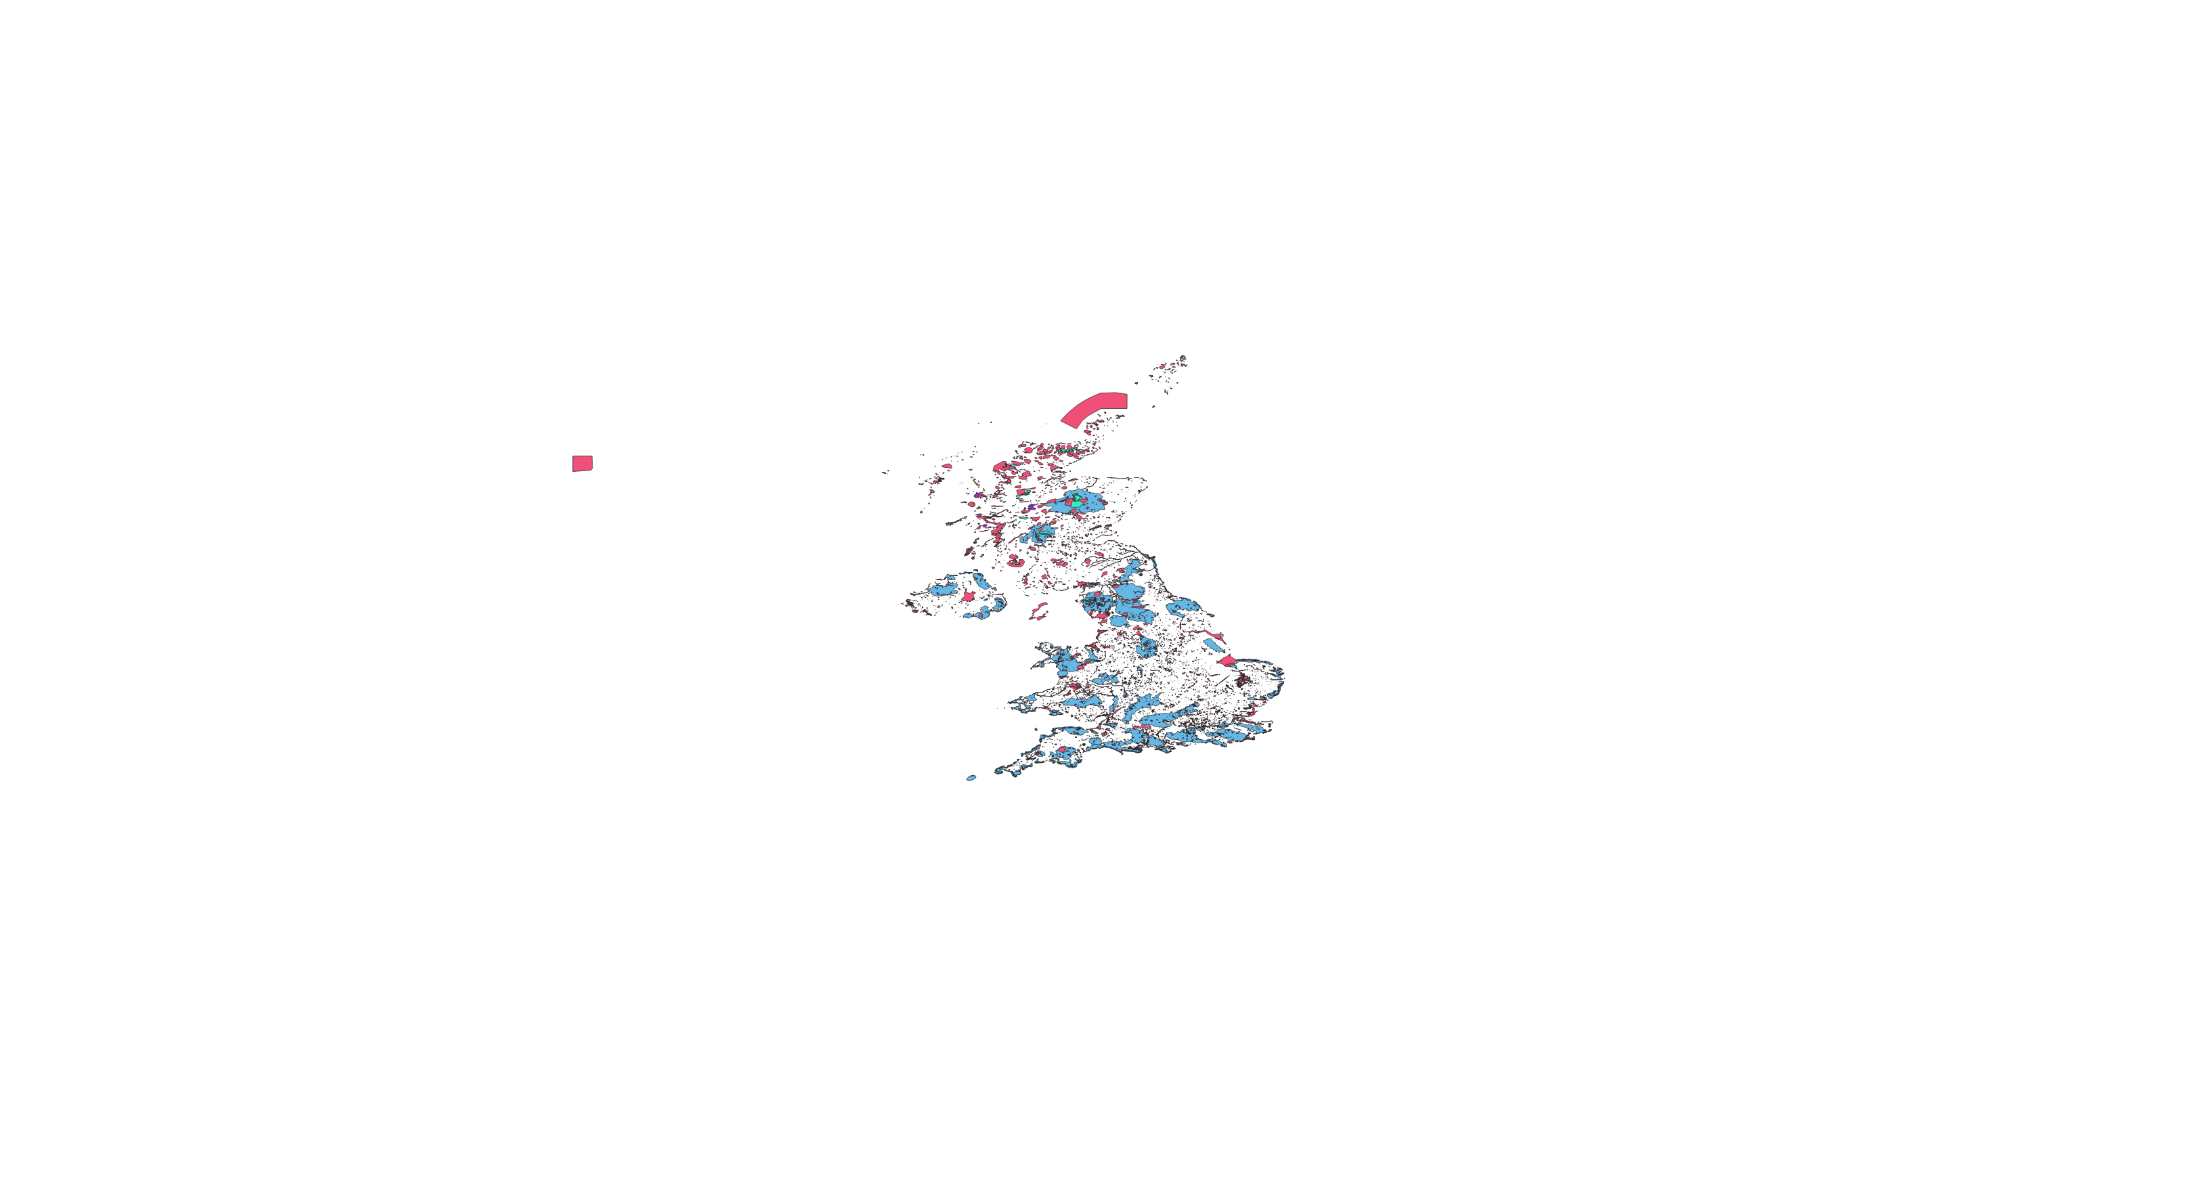
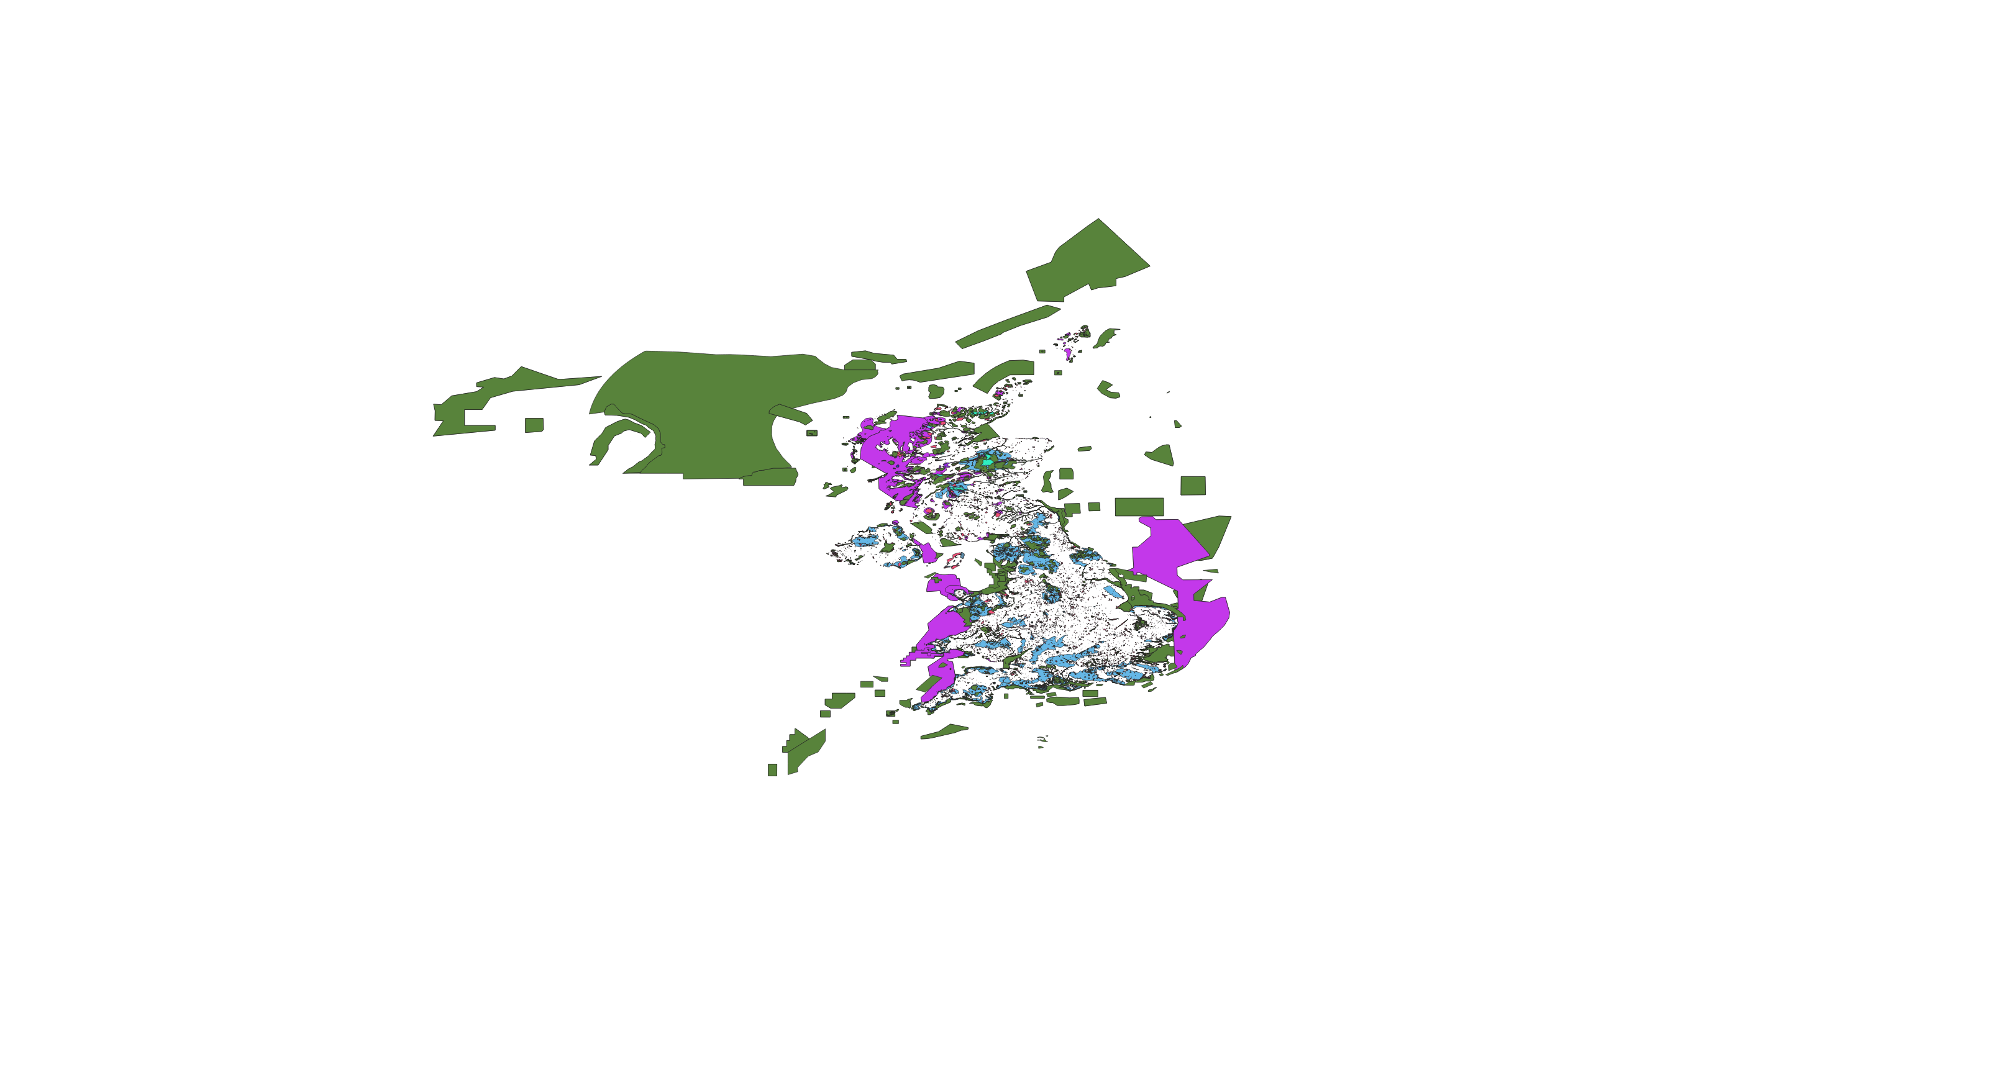
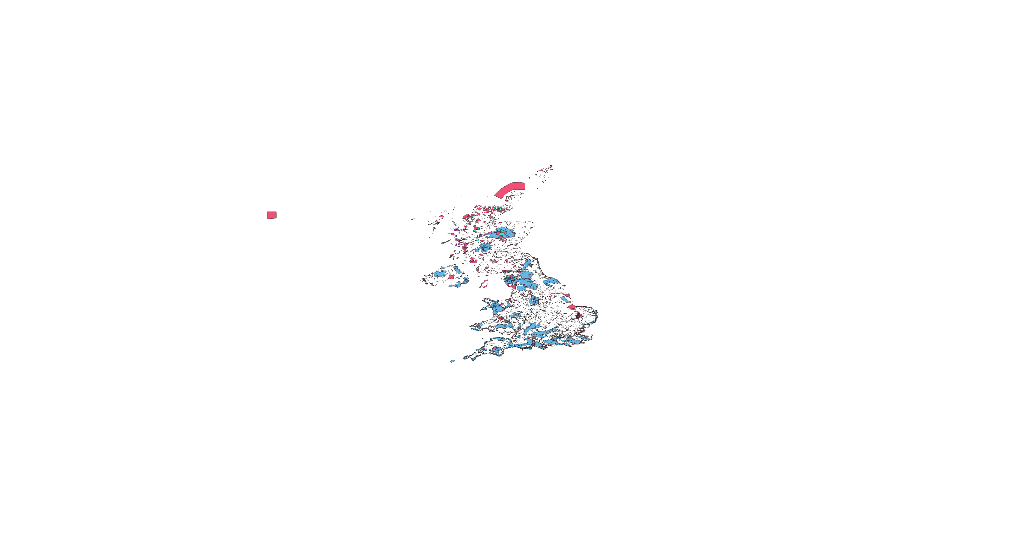



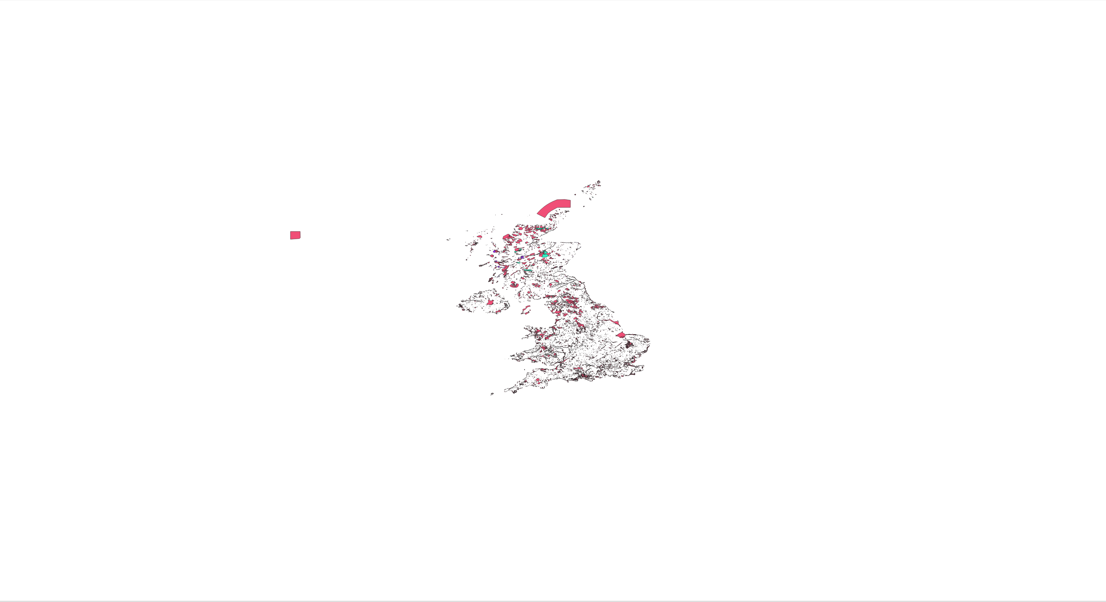

I, II
I, II, III, IV
I, II, III, IV, V
I, II, III, IV, V, VI
I, II, III, IV, V, VI and others
I, II, III, IV
I, II, III
I

